Slide 1
Prediction of customer repeat purchase patterns using ensemble classification and feature engineering
Group FP - 8

Slide 2
Problem Statement and Background
● Predicting the ‘Repeat Purchase’ behavior of an existing customer using ensemble classification model trained on the repeat purchase behaviors of a subset of customers
● We use historical transaction records of customers for over a year to predict ‘repeat transaction’ behavior of customers.
● Inspired from the ‘Acquire Valued Shoppers’ problem hosted on Kaggle.

Slide 3
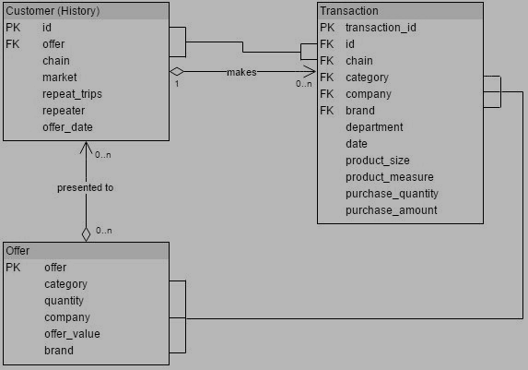
Data Description
TRANSACTIONS - Contains transaction history for all customers over a period of 1 year prior to their offered incentive.
HISTORY - Contains the incentive offered to each customer and information about the behavioral response to the incentive offered.
OFFERS - Contains information about the offers.

Slide 4
Data Science pipeline
● Exploratory Data Analysis: Identifying general trends and patterns in customer purchase history and visualizing them.
● Data Reduction/Cleaning Task: Filtering the irrelevant transactions where purchase amount or quantity is zero, transactions with missing values of category, brand or company etc. Reducing the dataset, which covers data related to valid coupons.
● Feature Engineering / Selection : Design and generate new features which aim for customer purchase behavior and Coupons targeted products. Identifying the set of features that are most predictive amongst the engineered features.
● Prediction: Training the model using generated features and xxx them for prediction of repeat purchase behavior on the test set.

Slide 5
Final Data Product
End product will be a classifier capable of learning repeat purchase behaviors of customers from past transactional patterns, which can be deployed for targeted offers disbursement to optimize the revenue of the company, as well increase customer loyalty for a brand/product.

